Slide 1
Physics 3 – Sept 3, 2019
Do Now: P3 Challenge –
If you have the following displacement versus time graph, draw the corresponding velocity versus time graph and the acceleration versus time graph. (4 regions)

Slide 2
Objectives/Agenda
Objective: 4.1
Agenda:
Types of Oscillation
Describing Simple Harmonic Motion (SHM)
Graphing SHM
Energy of a SHM
Assignment: p152 #1-5, SHM Worksheet

Slide 3
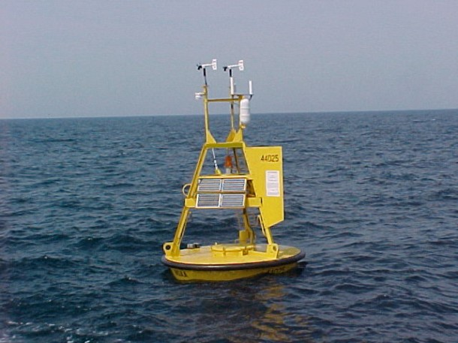
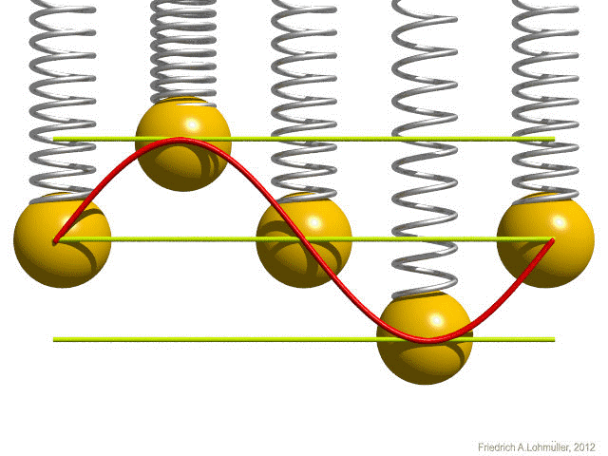
Examples of Oscillations

Slide 4
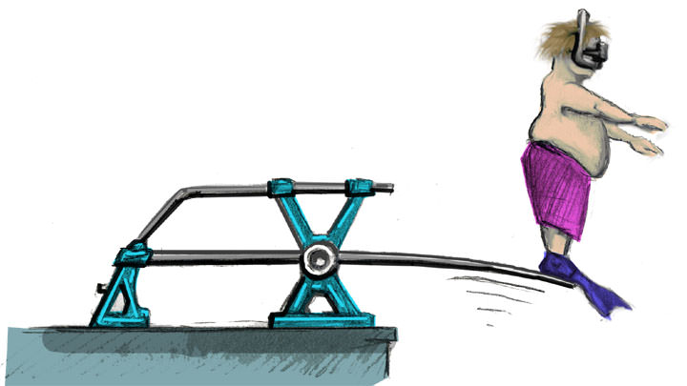
Examples of Oscillations
https://www.youtube.com/watch?v=SzbFdNlzD58
Trees in wind
https://www.youtube.com/watch?v=HB2jgJJG2is
Japanese Skyscrapers in 2011 earthquake

Slide 5
Simple Harmonic Motion
1) The period and amplitude are constant
Period is the length of time it takes for one complete oscillation. (A period begins and ends at the same displacement.) Symbol: T
Amplitude is the maximum displacement from the equilibrium displacement. (always a positive value) Symbol: A
2) The period is independent of the amplitude
3) The displacement, velocity and acceleration are sine or cosine functions of time.
4) The displacement is proportional to and opposite to a restoring force (Hooke’s Law)

Slide 6
Describing displacement of the mass
An oscillating object is assumed to be a point mass, though in practice it is best to use an object’s center of mass as a reference point for its displacement. In some situations, the edge of an object can be used as a reference point for displacement.
Create a graph for the displacement, x, of the block as a function of time.
Complete the graph for two periods.

Slide 7
Sine/Cosine for x, v, a
Sine or Cosine?? Because our mass started at maximum amplitude at t=0, the curve is a cosine. If the mass starts at the equilibrium and then starts to extend as it oscillates, then the function would be sine.
They are equivalent descriptions that only depend on when you start the clock.
Create the velocity vs. time graph that corresponds to this displacement vs time graph.
Notice that this is negative sine when we start with cosine. If we start with sine, we get cosine.

Slide 8
Sine/Cosine for x, v, a
Create the acceleration vs. time graph that corresponds to this velocity vs time graph.
Notice that this one is a negative cosine curve.
For beginning with sine and v = cosine, the acceleration would be negative sine.
Summary:
x | v | a
Cosine | Neg Sine | Neg Cosine
Sine | Cosine | Neg Sine

Slide 9
Hooke’s Law
Consider a graph with all three curves graphed at the same time.
Notice that the acceleration curve is proportional to the opposite of the displacement curve.
a  – x
Hooke’s Law: F = – kx = ma
a = – (k/m) x
This is one of the defining characteristics of SHM: that the position is proportional to an opposing force.

Slide 10
Deriving from sine/cosine model
Consider Graph of x = x_{o} cos ωt Displacement function of time.
Amplitude = x_{o}
Slope of displacement graph = velocity
Take the derivative v = – ω x_{o} sin ωt v_{max} = ω x_{o}
Graph of v = – ω x_{o} sin ωt Velocity function of time.
Slope of velocity graph = acceleration
Take the derivative again a = – ω² x_{o} cos ωt
Substitute a = – ω² x a_{max} = ω² x_{o}
Meets the condition for the acceleration to be proportional to and opposed to displacement! …. A restoring force
From Data Packet
𝜔=2𝜋/𝑇
𝑎=−𝜔²𝑥
𝑥=𝑥0sin𝜔𝑡; 𝑥=𝑥0cos𝜔𝑡
𝑣=𝜔𝑥0cos𝜔𝑡; 𝑣=−𝜔𝑥0sin𝜔𝑡

Slide 11
Mass on spring oscillation
Consider a = – ω² x
Also know from Hooke’s Law and the 2nd law, F = – kx = ma
Substitute for a – kx = m(– ω² x)
Simplify k = m ω² ← useful equation (not in data booklet)
Solve for ω, substitute into T = 2π/ ω gives equation in data booklet for period.
$$T=2π\sqrt{\frac{m}{k}}$$

Slide 12
Frequency and Phase Difference
Frequency is the number of complete oscillations in one second. Mathematically, it is the reciprocal of the period. Symbol: f $f= \frac{1}{T}$
The last variable that describes SHM is phase. Because it is usually described relative to some reference phase of zero degrees, it is best described as a phase difference.
Phase is expressed in degrees out of 360 or in radians. It represents how much a graph is shifted relative to some reference SHM graph.
Determine the phase difference of the purple and blue relative to the red graph.

Slide 13
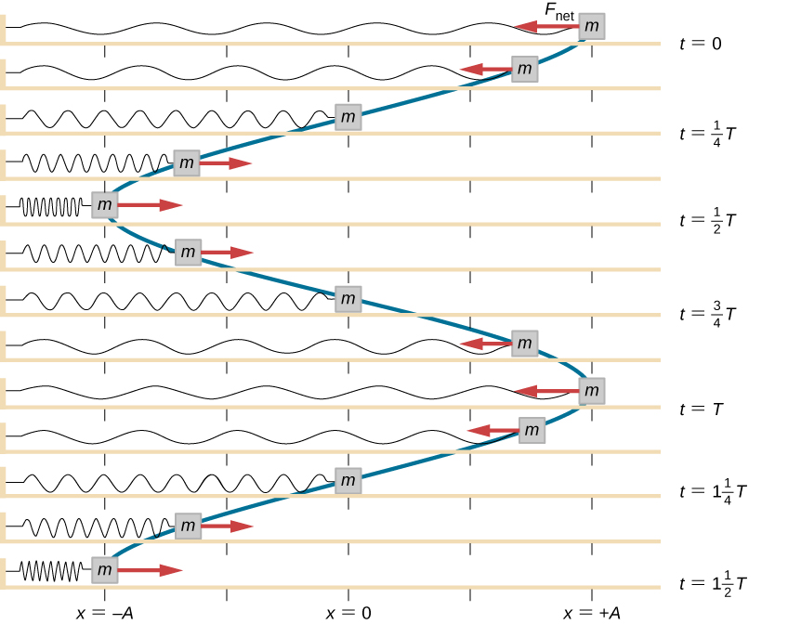
Energy in SHM
There’s not much more to say here that we don’t already know.
Two, possibly three, kinds of energy are involved. Recall kinetic energy is E_{K}= 1/2mv² E_{P} =1/2 kx² for a spring and E_{P} = mgh for gravitational potential energy differences due to height differences.
Use a vertical cosine curve to represent this oscillation and assess the amount and types of energy present at each 1/8 period for a horizontal oscillation. (Work in three groups)
Repeat assuming a vertical oscillation.

Slide 14
Total Energy of SHM
Because there are no nonconservative forces present in SHM, energy is conserved.
When the energy is all spring potential energy, we see that the total energy is proportional to the square of the amplitude.
This is an important general fact about SHM: E_{T}  A²
E_{T} = E_{P} + E_{K} = ½ mv²_{max} = ½ kA²

Slide 15
Exit Slip - Assignment
Exit Slip- a) Where within an oscillation is the oscillating particle moving the fastest? b) Describe the conditions when the displacement of the particle can be described by a cosine curve.
What’s Due? (Pending assignments to complete.)
p152 #1-5
SHM Worksheet
What’s Next? (How to prepare for the next day)
Read B.4 Damped Oscillations

